Slide 1

Igal Tabachnik @hmemcpy
Tips for Memory-Efficient .NET Applications

Slide 2
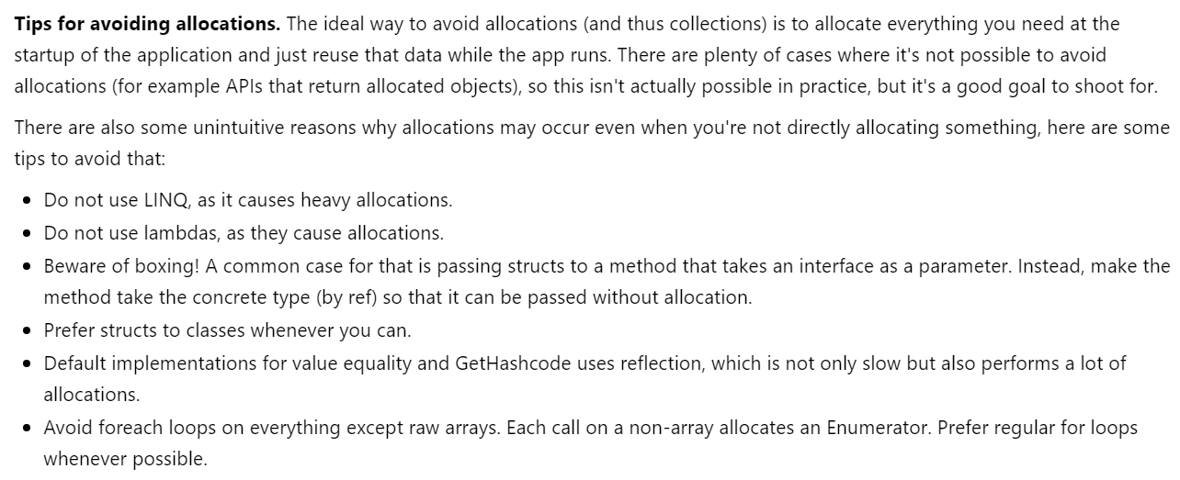
Performance tips (or myths?):
https://developer.microsoft.com/en-us/windows/holographic/performance_recommendations_for_unity

Slide 3
Disclaimers and caveats
Premature optimization
…is the root of all evil, 97% of the time
MEASURE ALL THE THINGS
otherwise, you’re guessing
GOTO 10
apply only in performance-critical situations

Slide 4
Goal: Avoid GC pressure
More memory traffic → frequent GC → poor performance
What can we do?
Simple: don’t allocate anything!
Harder than it looks
Allocation is EVERYWHERE, hidden

Slide 5
Examples of non-obvious allocations
LINQ
Lambdas
Boxing
Enumerators
Strings

Slide 6
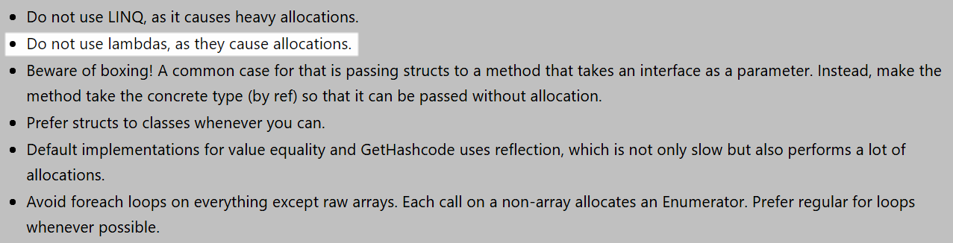
Myth #1: Lambdas are BAD!
Performance recommendations for Unity
https://developer.microsoft.com/en-us/windows/holographic/performance_recommendations_for_unity

Slide 7
Lambdas
public void M(IServiceProvider serviceProvider)
{
Task.Run(() => serviceProvider.Run("MyTask"));
}

Slide 8
Lambdas – Decompiled
[CompilerGenerated]
private sealed class <>c__DisplayClass0_0
{
public IServiceProvider serviceProvider;
internal object <M>b__0()
{
return this.serviceProvider.Run("MyTask");
}
}
public void M(IServiceProvider serviceProvider)
{
C.<>c__DisplayClass0_0 <>c__DisplayClass0_ = new C.<>c__DisplayClass0_0();
<>c__DisplayClass0_.serviceProvider = serviceProvider;
Task.Run(new Func<object>(<>c__DisplayClass0_.<M>b__0));
}

Slide 9
How to fix?
BAN LAMBDAS!
Avoid closures
Cached delegates (use static methods)
Pass through context values as parameters
When profiling, look for delegate (Action, Func) allocations
Look for +c__DisplayClass closure allocations

Slide 10
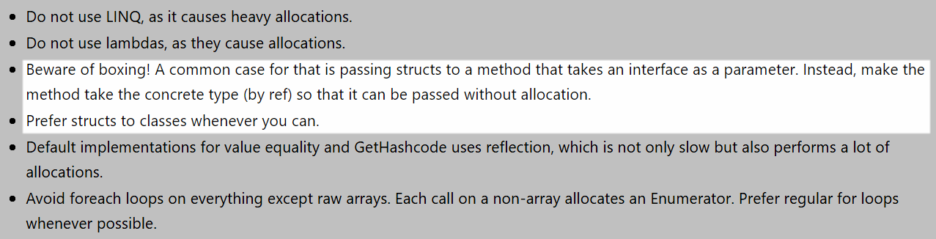
Myth #2: Boxing is BAD!
Performance recommendations for Unity
https://developer.microsoft.com/en-us/windows/holographic/performance_recommendations_for_unity

Slide 11
Boxing 101
object o = 42;
int i = (int)o;
Value types (structs, int, float, etc.)
Allocated on stack
Popped off at end of function
No garbage collection
Value type as object
Allocated on heap
Copied to heap
Passed as reference
Garbage collected
boxing
Notes:
Switch to boxing demo

Slide 12
How to fix?
Remove boxing
(e.g. call ToString() explicitly)
Method overloads with value types
Generic method parameters
Use structs for cheap short lived objects
Avoid interfaces with structs
Use concrete types
Signs of boxing: when profiling, look for value type instances on the heap (e.g. System.Int32)
Using as keys in dictionary: override Equals and GetHashCode manually – otherwise reflection is used (S-L-O-W)

Slide 13
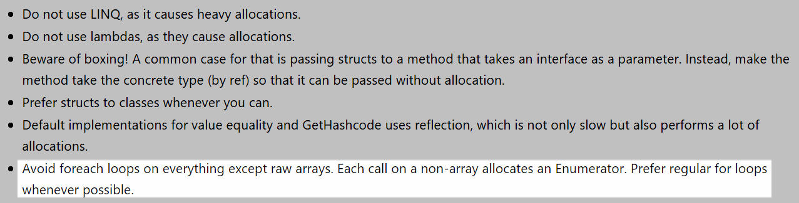
Myth #3: Collections are BAD!
Performance recommendations for Unity
https://developer.microsoft.com/en-us/windows/holographic/performance_recommendations_for_unity

Slide 14
IEnumerable<T> vs List<T>
readonly List<int> _numbers = new List<int> { 1, 2, 3, 4, 5 };
public void PrintNumbers(IEnumerable<int> numbers)
{
foreach (var number in numbers)
{
Console.WriteLine($"Number {number}");
}
}
vs
public void PrintNumbers(List<int> numbers)
{
foreach (var number in numbers)
{
Console.WriteLine($"Number {number}");
}
}
Notes:
Ask about what makes a collection ‘foreachable’
Show List.cs enumerator

Slide 15
IEnumerable<T> vs List<T> – Decompiled
// IEnumerable<int>
IL_0003: callvirt instance class
[mscorlib]System.Collections.Generic.IEnumerator`1<!0/*int32*/> class [mscorlib]System.Collections.Generic.IEnumerable`1<int32>::GetEnumerator()
...
IL_000c: callvirt instance !0/*int32*/ class [mscorlib]System.Collections.Generic.IEnumerator`1<int32>::get_Current()
vs
// List<int>
IL_0003: callvirt instance valuetype [mscorlib]System.Collections.Generic.List`1/Enumerator<!0/*int32*/> class [mscorlib]System.Collections.Generic.List`1<int32>::GetEnumerator()
...
IL_000d: call instance !0/*int32*/ valuetype [mscorlib]System.Collections.Generic.List`1/Enumerator<int32>::get_Current()

Slide 16
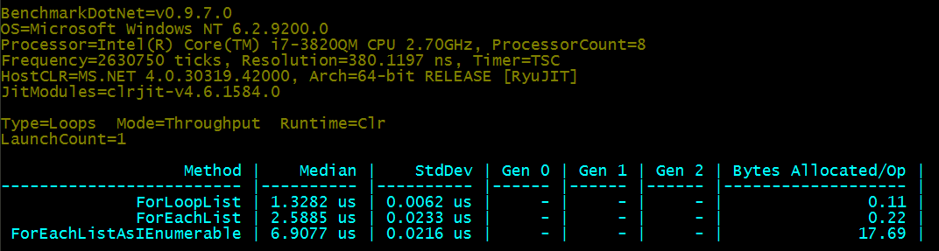
IEnumerable<T> vs List<T> – Benchmark

Slide 17
How to fix?
Use concrete collections
For custom collections, use struct/cached enumerators
Avoid boxing of enumerators
Prefer int[] over List<int>

Slide 18
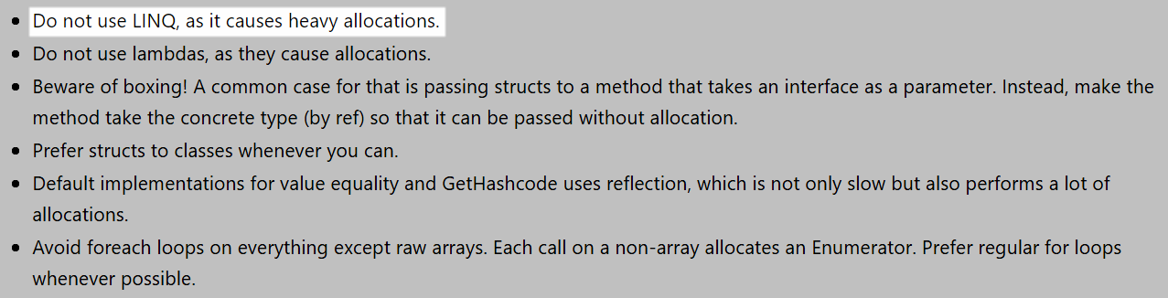
Myth #4: LINQ is BAD!
Performance recommendations for Unity
https://developer.microsoft.com/en-us/windows/holographic/performance_recommendations_for_unity

Slide 19
LINQ is actually pretty bad for perf!
Lambdas
closures, delegates
Iterators
state machines, boxing struct enumerators
Method chaining
iterators all the way down

Slide 20
How to fix?
You just don’t :(
Avoid on critical paths
Rewrite with old-fashioned loops

Slide 21
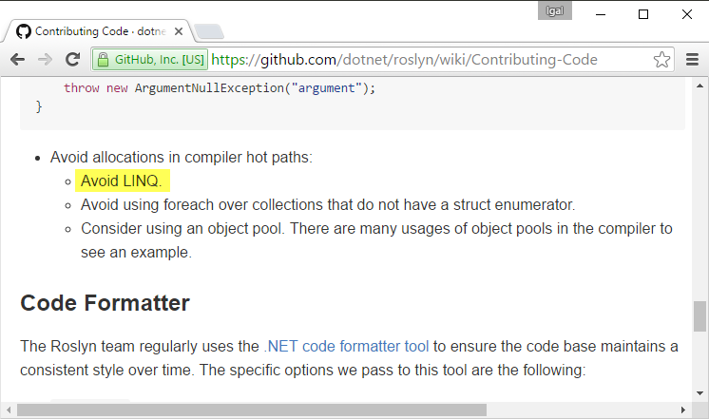
You’re not alone…
Roslyn bans LINQ in critical paths

Slide 22
Bonus: EVERYTHING IS BAD!

Slide 23
Params array
public void Log(string message, params object[] args)
{
_logger.AppendFormat(message, args);
}
Log("Hello");
Before .NET 4.6
After .NET 4.6/.NET Core
Log("Hello", new object[0]);
Log("Hello", System.Array.Empty<object>());

Slide 24
Enum.HasFlag
var modifiers = ConsoleModifiers.Control | ConsoleModifiers.Shift;
if ((modifiers & ConsoleModifiers.Control) != 0)
{
...
}
Enum.HasFlag introduced in .NET 4.0
if (modifiers.HasFlag(ConsoleModifiers.Control))
{
...
}

Slide 25
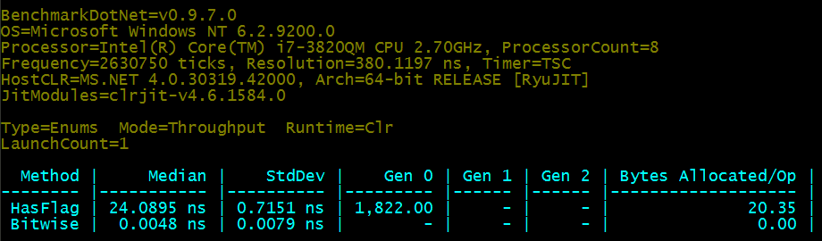
Enum.HasFlag – Benchmark

Slide 26
Summary
GOTO 10
Avoid hidden allocations in hot paths
In tight loops
library/util code
Know your tools, frameworks, and environments
Use the latest available .NET framework!
Optimize GC for your scenario (workstation vs server, concurrent vs background)
Measure and measure again!

Slide 27

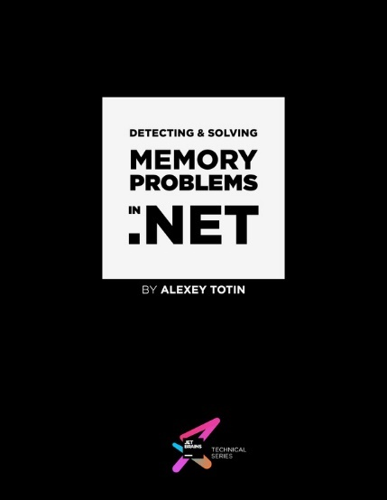


BenchmarkDotNet github.com/PerfDotNet/BenchmarkDotNet
ReSharper Heap Allocations Viewer github.com/controlflow/resharper-heapview
Roslyn Heap Allocation Analyzer github.com/mjsabby/RoslynClrHeapAllocationAnalyzer
.NET Perf Truths [PDF] bit.ly/dotnet-perf
bit.ly/redgate-mem-book
(free ebook)
bit.ly/jb-mem-book
(free ebook)
bit.ly/sela-dotnet-perf-book
(worth every penny ☺)
writinghighperf.net
(highly recommended)

Slide 28
Thank you!
Igal Tabachnik
@hmemcpy
hmemcpy@gmail.com

